Slide 1
COST BENEFIT ANALYSIS OF IMPROVED PATCHING WINDOW USING FAIR
Case Study Shared courtesy of RiskLens

Slide 2
ANALYSIS SCOPING
RISK SCENARIO DESCRIPTION
Lack of timely application patching introduces threats to the ERP system and restricted data (auditors uncovered that the actual patching window exceeded the patching policy)
ASSET(S) DESCRIPTION
ERP Patching Process
LOSS TYPE
Confidentiality
THREAT(S) DESCRIPTION
Advanced Persistent Threat (APT)

Slide 3
ANALYSIS SCOPING
Assessing Risk Reduction Through Comparison of Scenarios
Analyzed and quantified the risk for the ERP patching process in the current state
Analyzed and quantified the risk for the ERP patching process if the patching window was reduced

Slide 4
ANALYSIS RESULTS
RISK = Frequency x Magnitude of future loss. We express risk in terms of loss exposure.
Annualized Reduction in Loss Exposure (Risk)
Analysis | Minimum | Average | Maximum | CHANGE
Current State | $0 | $85.0M | $1.4B | Average Annualized Risk Reduction 49.5M
Improved Patching Process | $0 | $35.5M | $1.2B
Min / Max values represent the absolute minimum of simulation results.

Slide 5
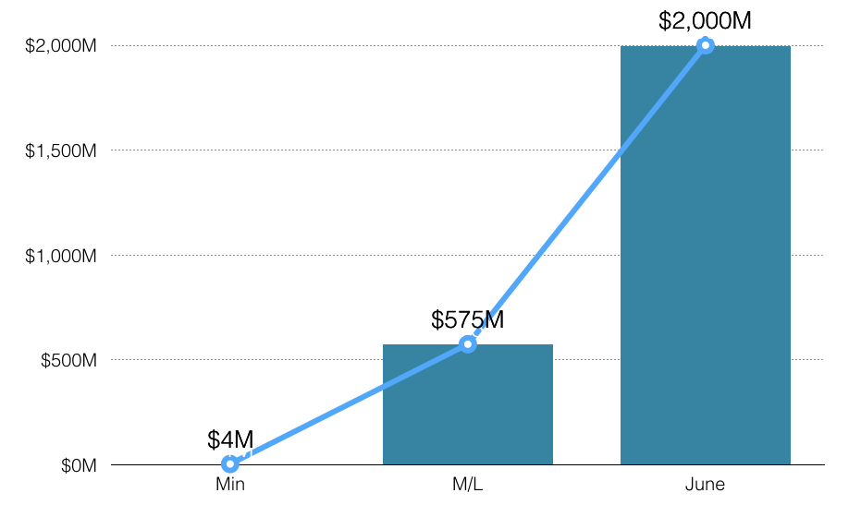
ANALYSIS RESULTS
ERP Impact Assumption
Single Loss Event Scenario (ML = Most Likely)

Slide 6
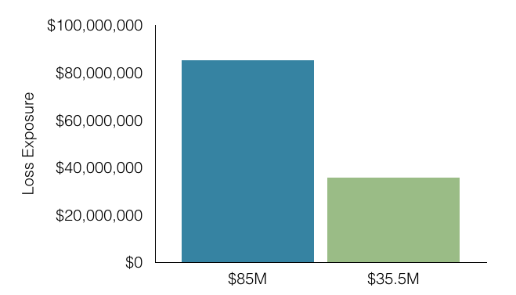
ERP AND SAP PATCHING
Average Annualized Loss Exposure
Reduction in Vulnerability*
Analysis | Vulnerability | CHANGE
Current State | 80% | Reduce Vulnerability by approx. 55%
Improved Patching Process | 25%
Vulnerability does not incorporate the susceptibility of underlying infrastructure components.
*Vulnerability = what percentage of attacks would become loss events

Slide 7
INTERPRETING RESULTS
Both Scenarios
Threat event frequency for each is a calibrated estimate taking into account input from the Security Operations Center (SOC)
Vulnerability is measured as it relates only to the patch, not applied to the system within each time window
Primary loss is based on data provided by the incident response team
Secondary loss is derived from a lookup table build based on data provided by the business units
Secondary loss magnitude is modeled based on confidential data and IP data
Frequency of fallout is assumed to be at or near 100% of events because of the nature of the data involved and of the profile of the threat community

Slide 8
INTERPRETING RESULTS
Current State Scenario
Resistance strength is measured here by looking at the backlog of patches outstanding
Future Forecasted Scenario
Resistance Strength is measured here by assuming all missing patches in the backlog are resolved
  Minimum resistance strength represents patches that live longer in the time window
  M/L expresses at any given time during the 90 day patch window how bad the missing patches are
  Max represents the least damaging patches that are more recent in the time window

Slide 9
ANALYSIS LEVERAGED
THE FAIR MODEL
Risk
Loss Event Frequency
Loss
Magnitude
Threat Event Frequency
Vulnerability
Primary Loss
Secondary Loss
Contact Frequency
Probability of Action
Threat Capability
Resistance Strength
Loss Event Frequency
Loss Magnitude

Slide 10
THE FAIR MODEL
Risk
Loss Event Frequency
Loss
Magnitude
Threat Event Frequency
Vulnerability
Primary Loss
Secondary Loss
Contact Frequency
Probability of Action
Threat Capability
Resistance Strength
Loss Event Frequency
Loss Magnitude

Slide 11
THE FAIR MODEL
Risk
Loss Event Frequency
Loss
Magnitude
Threat Event Frequency
Vulnerability
Primary Loss
Secondary Loss
Contact Frequency
Probability of Action
Threat Capability
Resistance Strength
Loss Event Frequency
Loss Magnitude

Slide 12
ANALYSIS INPUT
PRIMARY LOSSES
Incident response
Investigation
SECONDARY LOSSES
Notification / credit monitoring
Regulatory notification
Possible fines / judgments
Customer service requests
Potential litigation
Loss of current/future customers (reputation)
Card replacement

Slide 13
DECISION SUPPORT / ROI
THE RISK ANALYSIS SUPPORTED
Forecasting risk reduction that can be achieved by consistently patching within 90-day window down from 180 days
Risk-based rationale for cleaning up current backlog
Using metrics to resolve a conflicting discussion between auditors and IT about the value of reducing the patch window and meeting the requirements of the patching policy
  Analysis demonstrated that risk quantification can be integrated into customer’s risk analysis process
  While this new patching process will increase operational costs, the forecasted risk reduction is multiple times greater.

