Slide 1
USING FAIR, DOES TRAINING HELP REDUCE SPEAR PHISHING RISK?
Case Study Shared courtesy of RiskLens

Slide 2
ANALYSIS SCOPING
RISK SCENARIO DESCRIPTION
Understand if training can reduce risk associated with spear and regular phishing
ASSET(S) DESCRIPTION
Sensitive customer data (PII & potentially HIPAA) stored on internal systems
LOSS TYPE
Confidentiality
THREAT(S) DESCRIPTION
Targeted spear and regular phishing attacks by external threats

Slide 3
ANALYSIS SCOPING
Assessing Risk Reduction By Comparison of Scenarios
Assessed current state’s risk based on known controls in place today*
Assessed how much risk there would be, given the implementation of a phishing awareness/training program
*ASSUMPTION: Current state included various email filtering/gateway controls that reduce the number of phishing emails that arrive in an employee’s inbox.

Slide 4
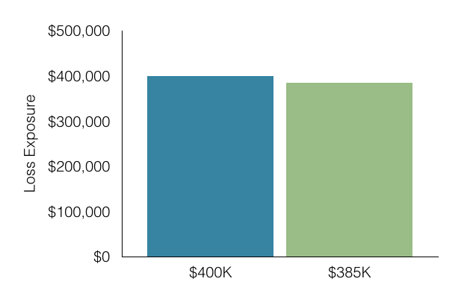
ANALYSIS RESULTS
RISK = Frequency x Magnitude of future loss. We express risk in terms of loss exposure.
ANNUALIZED REDUCTION IN LOSS EXPOSURE (RISK)
Analysis | Minimum* | Average | Maximum* | CHANGE
Current State | $4K | $400K | $2.3M | Average loss exposure reduction $15K
w/ Awareness Training | $2K | $385K | $2.2M
*Min represents the more probable 10th percentile of simulation results.
*Max represents the more probable 90th percentile of simulation results.

Slide 5
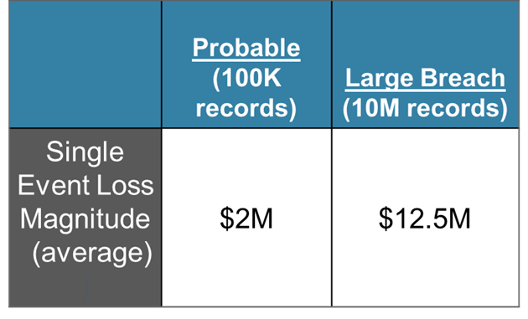
ANALYSIS RESULTS
Estimated Loss Exposure for a Single Event
* There is an additional probability assigned to the likelihood; when a phishing email campaign is successful, the threat actor is able to leverage that foothold to identify, obtain, and exfiltrate sensitive data successfully.

Slide 6
ANALYSIS RESULTS
Interpret Results
AWARENESS AND TRAINING
  Reduce the probability that any phishing emails that get through the email gateway and filtering would be opened and some action taken by an employee
AWARENESS CAMPAIGN
  Estimated* to reduce probability of employee action by 8-25%
Important Note: We defined a phishing campaign as a “threat event”. A single spear or regular phishing campaign often includes many individual emails.
*using an uncertain distribution

Slide 7
ANALYSIS RESULTS
Why Is Change So Small?
Industry data on phishing campaigns show
  90% success probability
  99% if run a second time
It only takes one employee taking action for the threat to gain a foothold in the
network.

Slide 8
ANALYSIS LEVERAGED
THE FAIR MODEL
Risk
Loss Event Frequency
Loss
Magnitude
Threat Event Frequency
Vulnerability
Primary Loss
Secondary Loss
Contact Frequency
Probability of Action
Threat Capability
Resistance Strength
Loss Event Frequency
Loss Magnitude

Slide 9
THE FAIR MODEL
Risk
Loss Event Frequency
Loss
Magnitude
Threat Event Frequency
Vulnerability
Primary Loss
Secondary Loss
Contact Frequency
Probability of Action
Threat Capability
Resistance Strength
Loss Event Frequency
Loss Magnitude

Slide 10
ANALYSIS CONSIDERATIONS
Frequency of phishing campaign emails landing in employee inboxes
Estimating the resistance of the workstation based on configuration/patching
The probability that an employee will take action on the email by
  clicking links
  opening attachments
  providing sensitive information

Slide 11
THE FAIR MODEL
Risk
Loss Event Frequency
Loss
Magnitude
Threat Event Frequency
Vulnerability
Primary Loss
Secondary Loss
Contact Frequency
Probability of Action
Threat Capability
Resistance Strength
Loss Event Frequency
Loss Magnitude

Slide 12
ANALYSIS INPUT
PRIMARY LOSSES
Incident response
Investigation
SECONDARY LOSSES
Notification / credit monitoring
Regulatory notification
Possible fines / judgments
Customer service requests
Potential litigation
Loss of current/future customers (reputation)
Card replacement

Slide 13
DECISION SUPPORT / ROI
THIS ANALYSIS SUPPORTED MANAGEMENT’S PRIORITIZATION
  Training did not show any material reduction of risk associated with phishing campaigns
  Management decided to pursue an alternative phishing-related control, email sandboxing, over training
  Sandboxing has higher costs, but the risk reduction was far more significant (separate analysis conducted)

