Slide 1
COST BENEFITS OF IMPLEMENTING CREDIT CARD DATABASE TOKENIZATION USING FAIR
Case Study Shared courtesy of RiskLens

Slide 2
ANALYSIS SCOPING
RISK SCENARIO DESCRIPTION
Understand how much credit card number tokenization can reduce the risk associated with the card datastore
ASSET(S) DESCRIPTION
Credit card data in the Card Data Environment (CDE)
LOSS TYPE
Confidentiality
THREAT(S) DESCRIPTION
Organized cyber criminals motivated to monetize stolen card data through underground markets

Slide 3
ANALYSIS SCOPING
Assessing Risk Reduction By Comparison of Scenarios:
Assessed how much risk a critical datastore has when storing full credit card numbers
Assessed level of risk for applications using the primary datastore
Assessed how much risk the datastore will have using a tokenized form*
*Assumption:
There is still a low probability that tokenized data can be compromised by:
Theft of the data in transit (potential Point-of-Sale attack)
Compromised tokenization data source and/or process
Both were considered in the analysis.

Slide 4
ANALYSIS SCOPING
INTERPRET RESULTS:
Look at the risk reduction from two perspectives:
Reduction in total loss exposure (annualized risk)
Reduction in per scenario magnitude

Slide 5
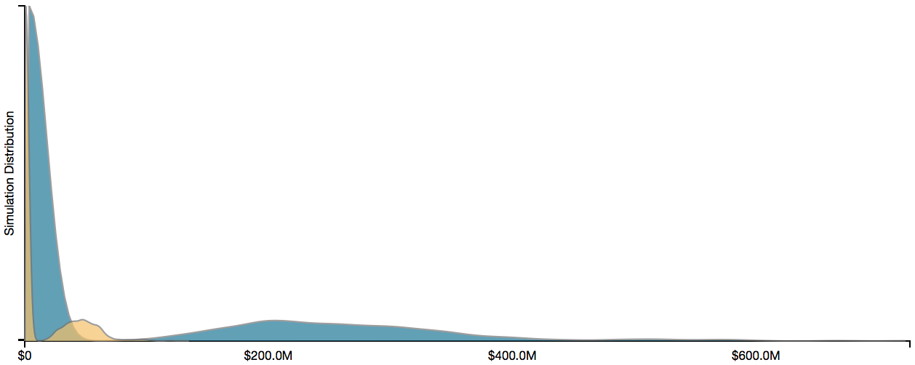
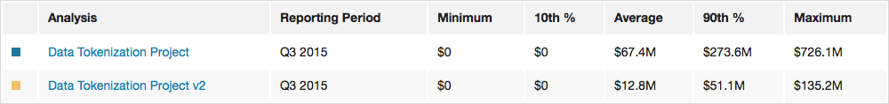
ANALYSIS RESULTS
RISK = Frequency x Magnitude of future loss. We express risk in terms of loss exposure.
ANNUALIZED REDUCTION IN LOSS EXPOSURE (RISK)

Slide 6
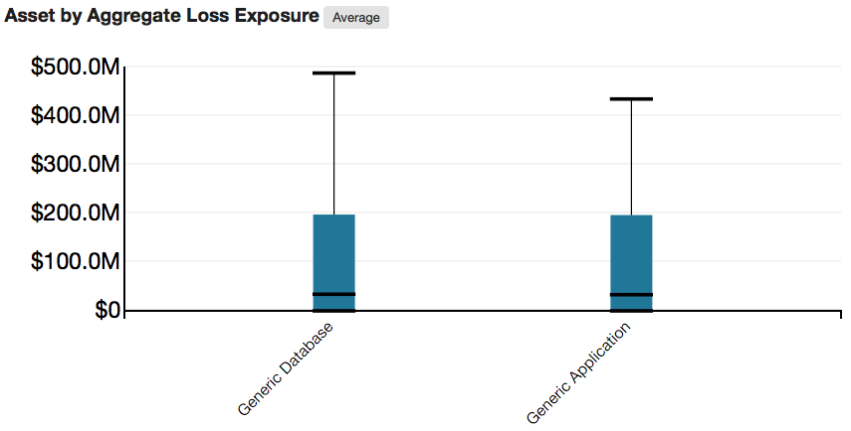
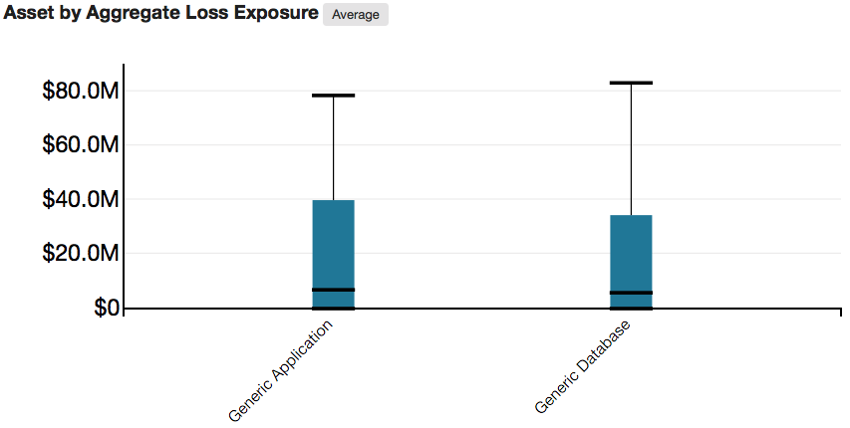
ANALYSIS RESULTS
Change in Average Loss Exposure Range for Each Component
CURRENT
FUTURE

Slide 7
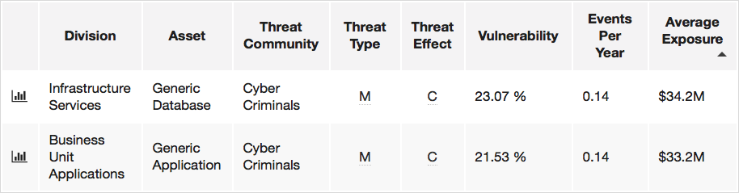
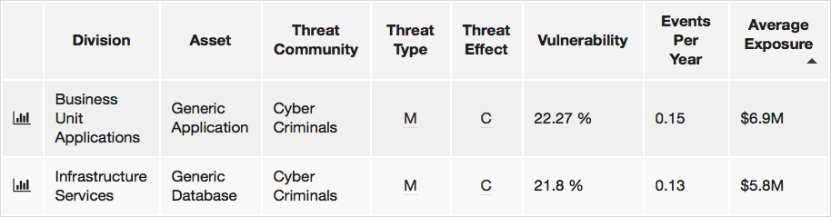
ANALYSIS RESULTS
Change in Average Loss Exposure By Scenario
CURRENT
FUTURE
7

Slide 8
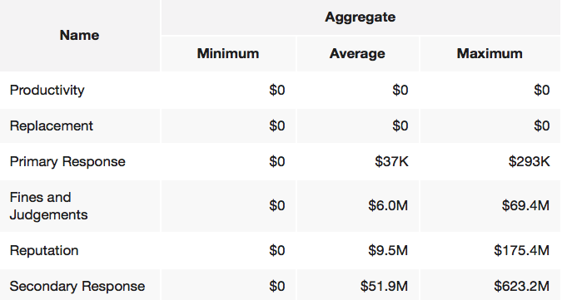
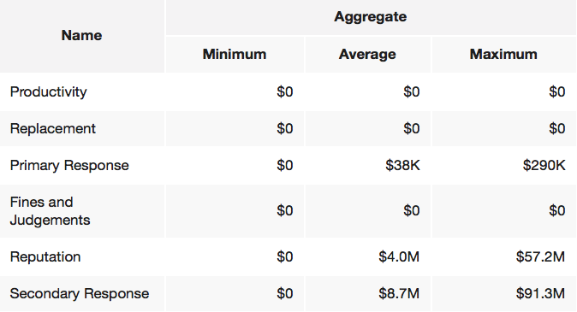
ANALYSIS RESULTS
Change in Loss Exposure Category By Scenario
Current
Future

Slide 9
ANALYSIS LEVERAGED THE FAIR MODEL
Risk
Loss Event Frequency
Loss Magnitude
Threat Event Frequency
Vulnerability
Primary Loss
Secondary Loss
Contact Frequency
Probability of Action
Threat Capability
Resistance Strength
Loss Event Frequency
Loss Magnitude

Slide 10
THE FAIR MODEL
Risk
Loss Event Frequency
Loss
Magnitude
Threat Event Frequency
Vulnerability
Primary Loss
Secondary Loss
Contact Frequency
Probability of Action
Threat Capability
Resistance Strength
Loss Event Frequency
Loss Magnitude

Slide 11
ANALYSIS CONSIDERATIONS
Frequency of attacks by each threat community
Estimating the capability (skills & resources) of the scoped threat community
How vulnerable a given system is by evaluating the following factors:
Authentication
Access Privileges
Patching / Structural Integrity

Slide 12
THE FAIR MODEL
Risk
Loss Event Frequency
Loss Magnitude
Threat Event Frequency
Vulnerability
Primary Loss
Secondary Loss
Contact Frequency
Probability of Action
Threat Capability
Resistance Strength
Loss Event Frequency
Loss Magnitude

Slide 13
ANALYSIS INPUT
PRIMARY LOSSES
Incident response
Investigation
SECONDARY LOSSES
Notification / credit monitoring
Regulatory notification
Possible fines / judgments
Customer service requests
Potential litigation
Loss of current/future customers (reputation)
Card replacement

Slide 14
DECISION SUPPORT / ROI
THE ORGANIZATION WAS ABLE TO
Quantify and compare the current and future risk exposure
Fully justify and fund stalled tokenization projects across all credit card databases

